Slide 1

Neural Networks Bootcamp Data Science & Machine Learning
Bruno motta

Slide 2
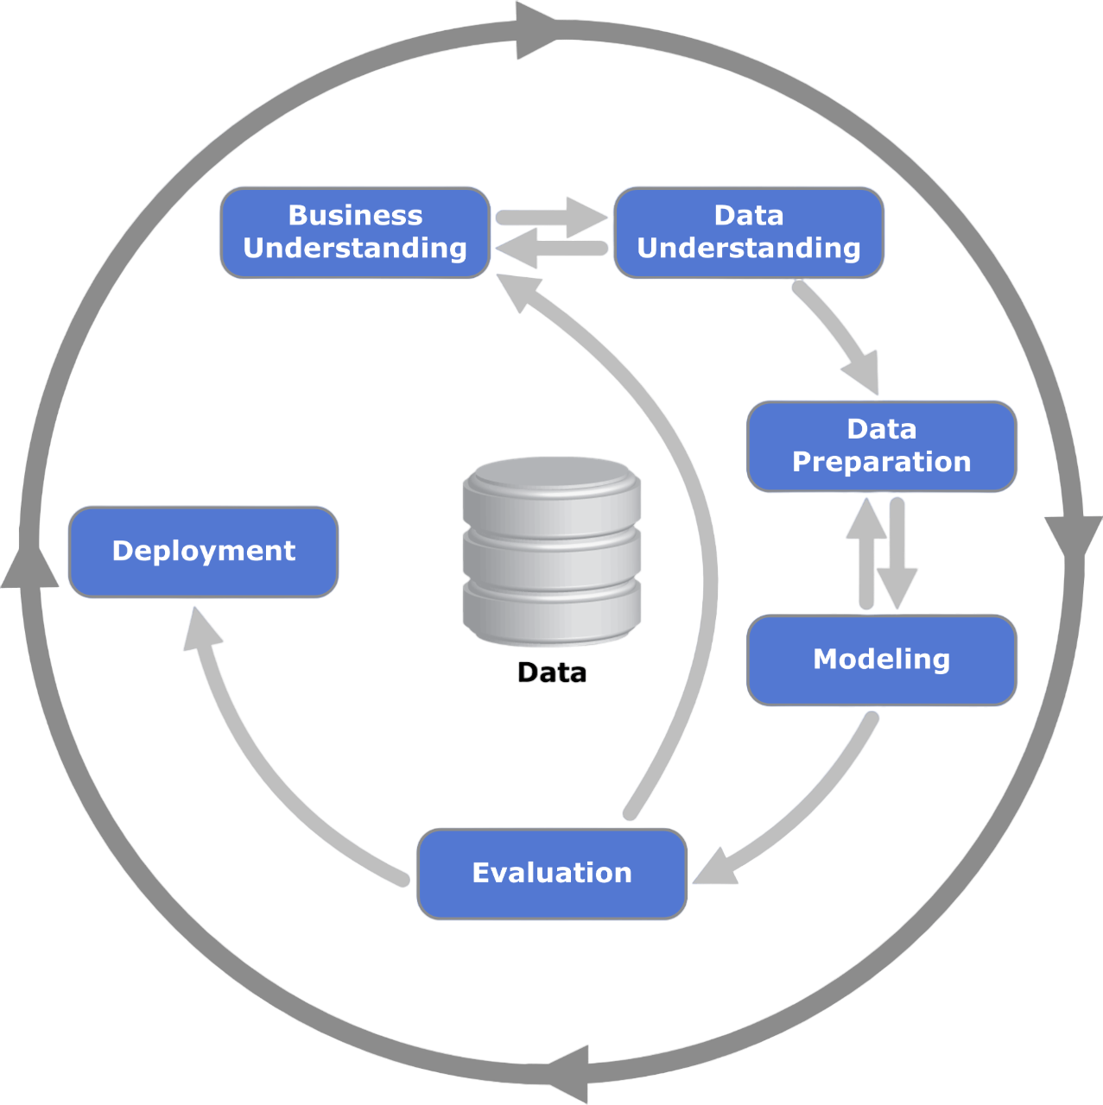
Summary
Business Understanding
Data Understanding
Data Preparation
Modelling
Evaluation
Deployment

Slide 3
Business understanding

Slide 4
KAGGLE COMPETITION [Link]
GOAL OF THE COMPETITION
The goal of this competition is to predict if a person has any of three medical conditions. You are being asked to predict if the person has one or more of any of the three medical conditions (Class 1), or none of the three medical conditions (Class 0). You will create a model trained on measurements of health characteristics.
To determine if someone has these medical conditions requires a long and intrusive process to collect information from patients. With predictive models, we can shorten this process and keep patient details private by collecting key characteristics relative to the conditions, then encoding these characteristics.
Your work will help researchers discover the relationship between measurements of certain characteristics and potential patient conditions.

Slide 5
CONTEXT
They say age is just a number but a whole host of health issues come with aging. From heart disease and dementia to hearing loss and arthritis, aging is a risk factor for numerous diseases and complications. The growing field of bioinformatics includes research into interventions that can help slow and reverse biological aging and prevent major age-related ailments. Data science could have a role to play in developing new methods to solve problems with diverse data, even if the number of samples is small.
Currently, models like XGBoost and random forest are used to predict medical conditions yet the models' performance is not good enough. Dealing with critical problems where lives are on the line, models need to make correct predictions reliably and consistently between different cases.

Slide 6
Founded in 2015, competition host InVitro Cell Research, LLC (ICR) is a privately funded company focused on regenerative and preventive personalized medicine. Their offices and labs in the greater New York City area offer state-of-the-art research space. InVitro Cell Research's Scientists are what set them apart, helping guide and defining their mission of researching how to repair aging people fast.
In this competition, you’ll work with measurements of health characteristic data to solve critical problems in bioinformatics. Based on minimal training, you’ll create a model to predict if a person has any of three medical conditions, with an aim to improve on existing methods.
You could help advance the growing field of bioinformatics and explore new methods to solve complex problems with diverse data.

Slide 7
data understanding

Slide 8
DATASET DESCRIPTION
The competition data comprises over fifty anonymized health characteristics linked to three age-related conditions. Your goal is to predict whether a subject has or has not been diagnosed with one of these conditions -- a binary classification problem.
Note that this is a Code Competition, in which the actual test set is hidden. In this version, we give some sample data in the correct format to help you author your solutions. When your submission is scored, this example test data will be replaced with the full test set. There are about 400 rows in the full test set.

Slide 9
FILES AND FIELD DESCRIPTIONS
train.csv - The training set.
Id → Unique identifier for each observation.
AB-GL → Fifty-six anonymized health characteristics. All are numeric except for EJ, which is categorical.
Class → A binary target: 1 indicates the subject has been diagnosed with one of the three conditions, 0 indicates they have not.
test.csv - The test set. Your goal is to predict the probability that a subject in this set belongs to each of the two classes.

Slide 10
FILES AND FIELD DESCRIPTIONS
greeks.csv - Supplemental metadata, only available for the training set.
Alpha → Identifies the type of age-related condition, if present.
A: No age-related condition. Corresponds to class 0.
B, D, G: The three age-related conditions. Correspond to class 1.
Beta, Gamma, Delta: Three experimental characteristics.
Epsilon → The date the data for this subject was collected.
Note that all of the data in the test set was collected after the training set was collected.
sample_submission.csv - A sample submission file in the correct format. See the Evaluation page for more details.

Slide 11
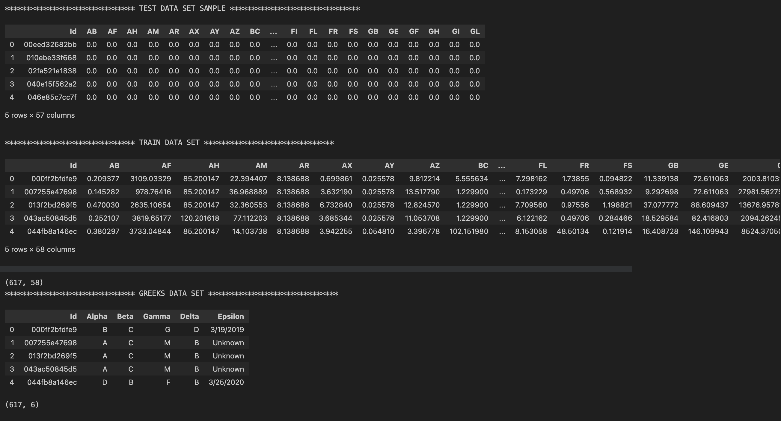
IMPORTING AND VISUALIZING DATA SETS
We can notice the Test set has only 5 rows and all features are Zeros. It’s only available to show an example of the set that will be used to rank the submissions.

Slide 12
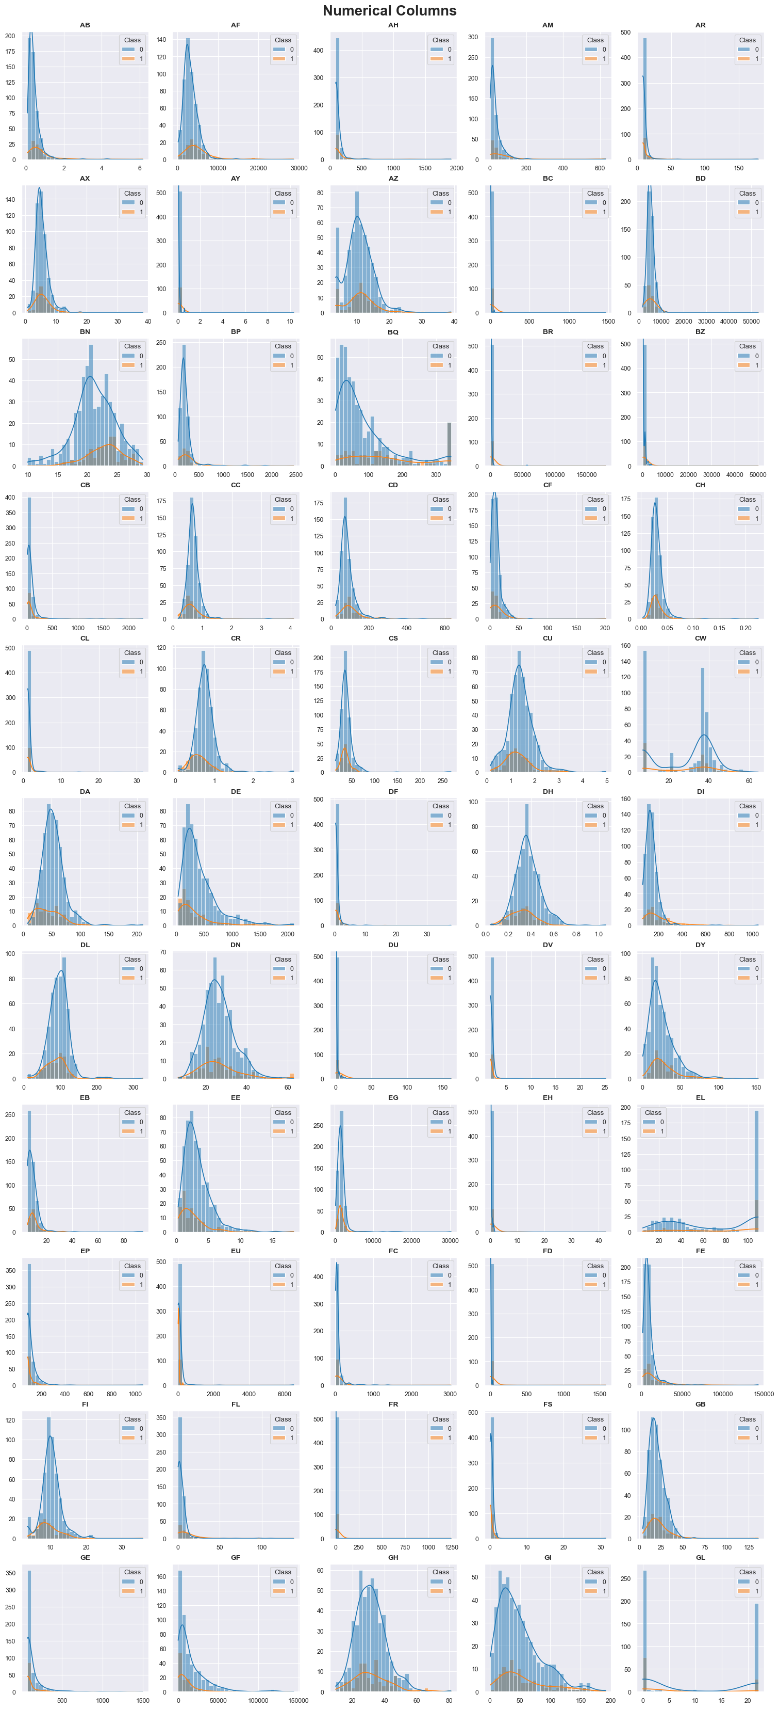
TRAIN SET - DATA DISTRIBUTION

Slide 13
TRAIN SET - DATA DISTRIBUTION

Slide 14
TRAIN SET - DATA DISTRIBUTION

Slide 15
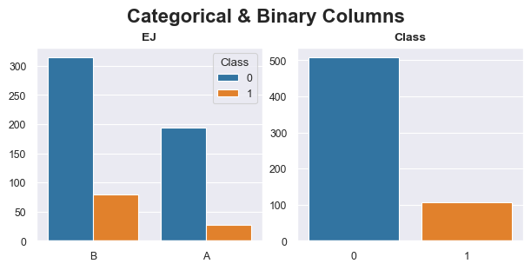
TRAIN SET - DATA DISTRIBUTION

Slide 16
TRAIN SET - DATA DISTRIBUTION
Observations:
The data set is very imbalanced, with a proportion of 5:1 Classes 0 to 1.
There’s no variable that distinguishes completely both classes.
There’s no variable that can be only found in 1 of the classes.
The range of values varies a lot between features and needs to be scaled.
In most cases, the distribution is similar between classes, with little variations.

Slide 17
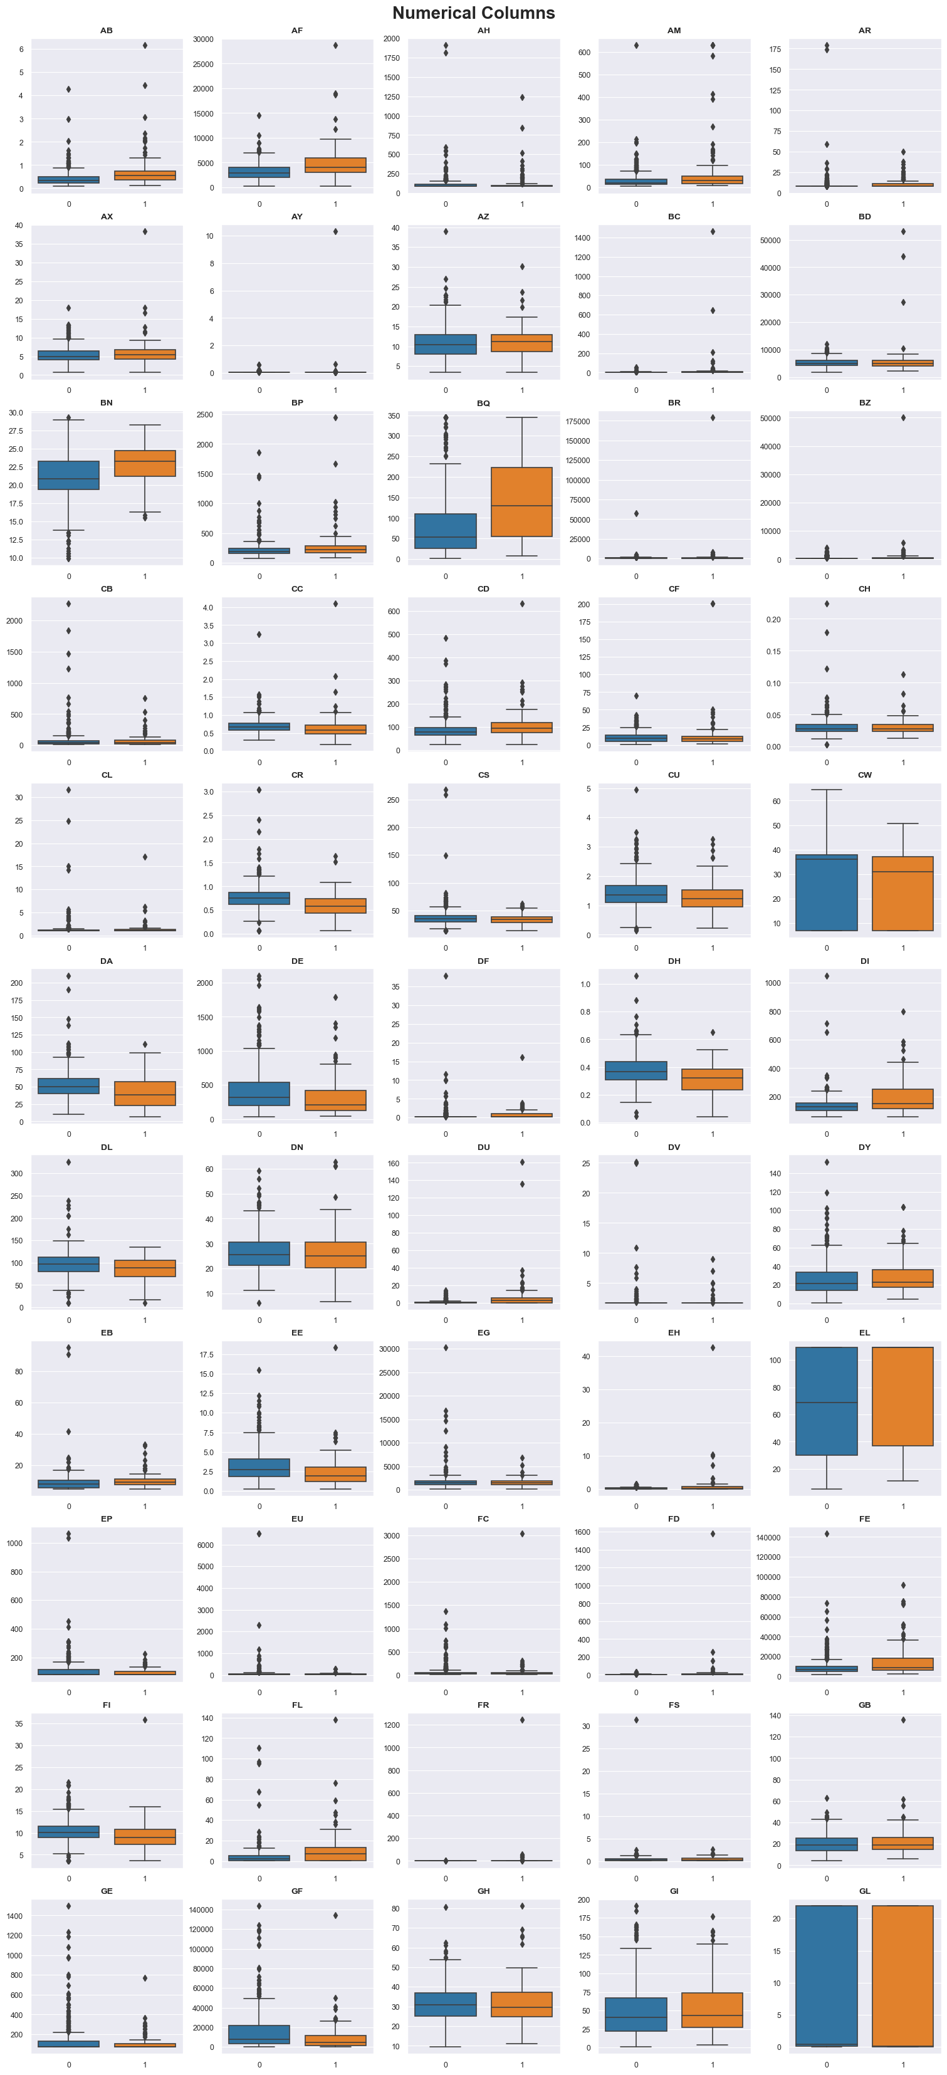
TRAIN SET - BOX PLOTS

Slide 18
TRAIN SET - BOX PLOTS

Slide 19
TRAIN SET - BOX PLOTS

Slide 20
TRAIN SET - BOX PLOTS

Slide 21
TRAIN SET - BOX PLOTS
Observations:
Almost all features have outliers for both classes.
Some features have outliers completely apart from the rest of the data set, but since it happens for both classes and in different features, I won’t remove them for now.
For all the features, the Interquartile Ranges (IQR) overlap between classes. Making it difficult to separate them with individual features.

Slide 22
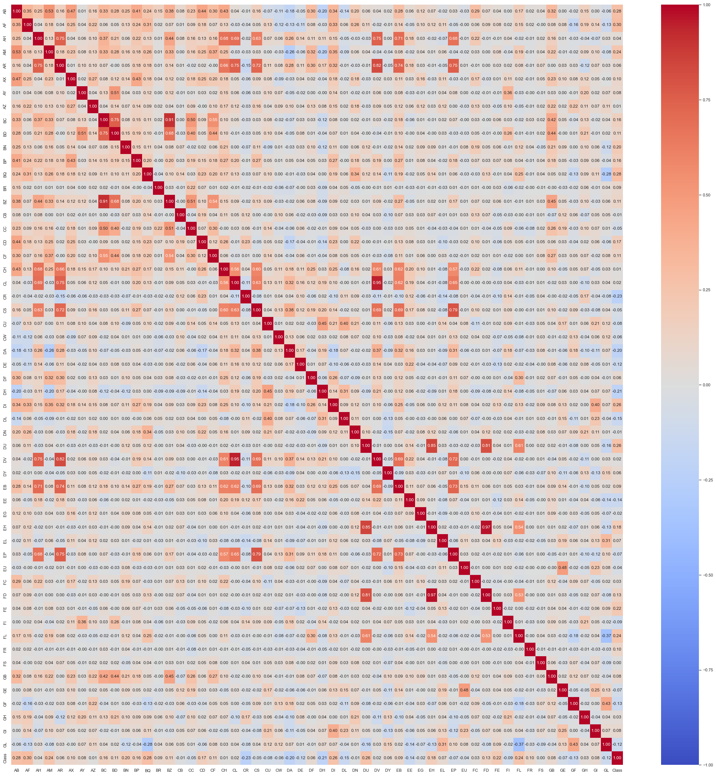
TRAIN SET - CORRELATION ANALYSIS

Slide 23
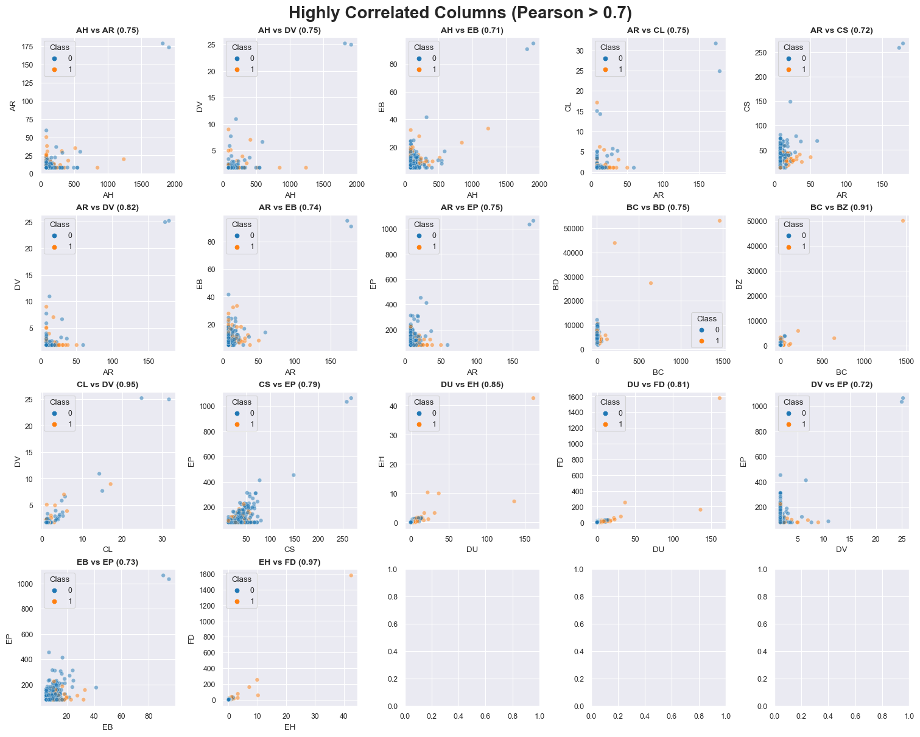
TRAIN SET - CORRELATION ANALYSIS

Slide 24
TRAIN SET - CORRELATION ANALYSIS
Observations:
From the heatmap, we find that most of the features are not correlated, with a few of them showing a high positive correlation.
From the scatter plots, with a ± 0.7 Pearson threshold, we find 17 features with a highly positive correlation. BUT, all of them show just a few outliers (2-5) very far from the rest of the data, which are giving this false alarm of a high correlation.

Slide 25
DECISIONS BASED ON DATA UNDERSTANDING
The categorical variable “EJ” has only 2 values, A and B. To avoid increasing the dimensions of the data set, it will be encoded as 0 and 1.
Due to the different ranges and distributions, the features will be normalized and standardized.
Due to the large number of features, PCA will be implemented to reduce the dimensionality of the data set.
Initially, no variable will be removed from the model, but further trials can be performed in this sense.

Slide 26
data PREPARATION

Slide 27
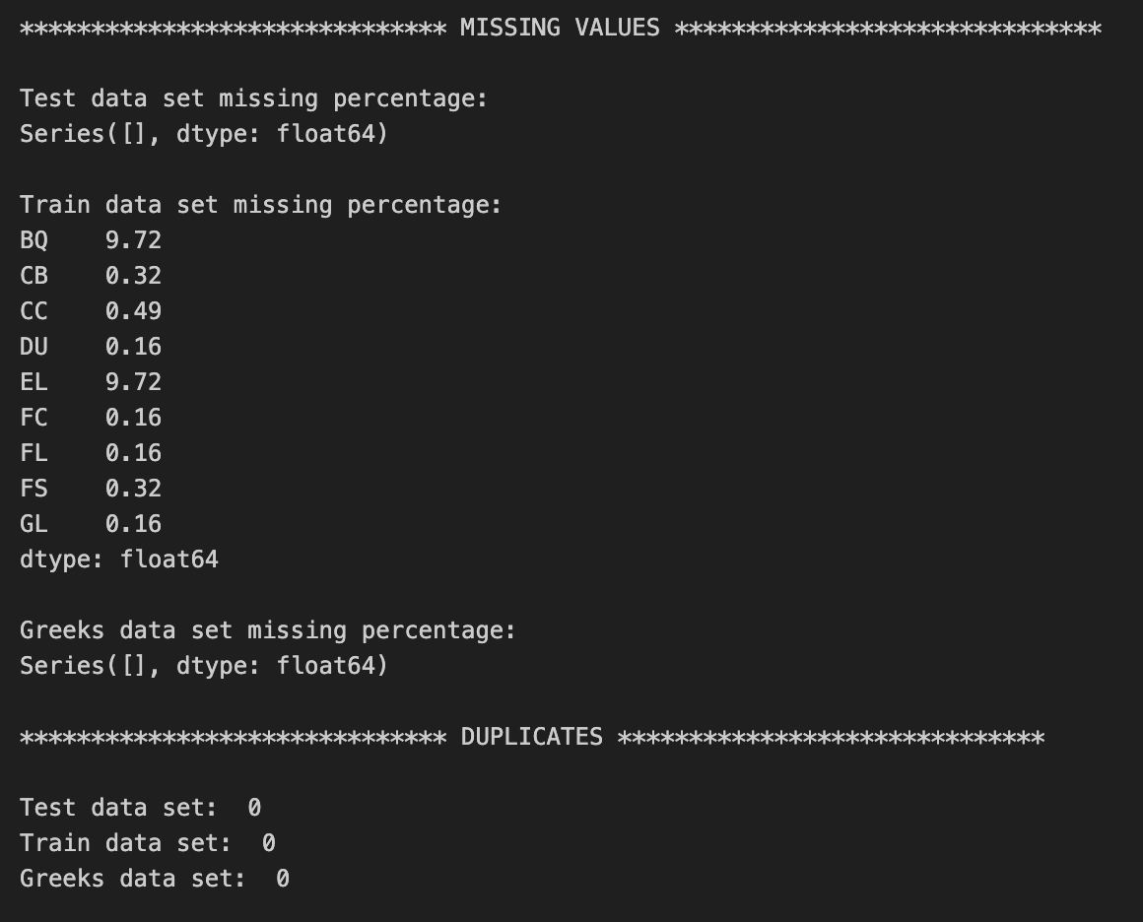
MISSING VALUES AND DUPLICATES
There are 9 out of 57 features with missing values in the Train sets, most of them have less than 0.5% of missing values, but 2 features have close to 10% of missing values.
Possible Strategies:
1. Remove rows with missing values
2. Remove columns with missing values
3. Impute missing values

Slide 28
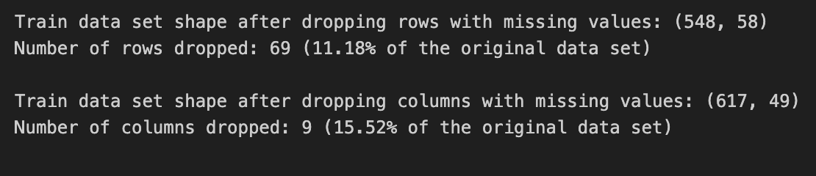
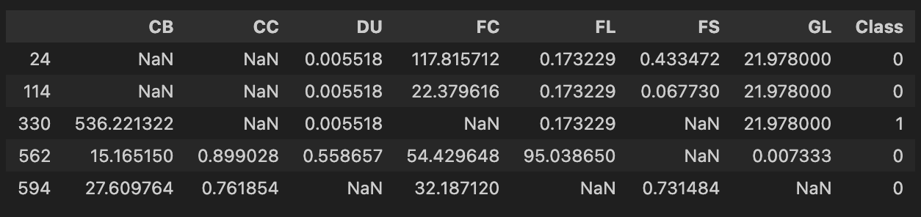
HANDLING MISSING VALUES
Removing all the rows or all the columns with missing values from the original train set would represent a loss of 11% and 15% of data, respectively. That’s not a good option!
Considering all the columns with less than 0.5% of missing values together, they represent 0.8% of the total observations, and the Class distribution within it is similar to the whole data set:
Decision: Remove these 5 rows!

Slide 29
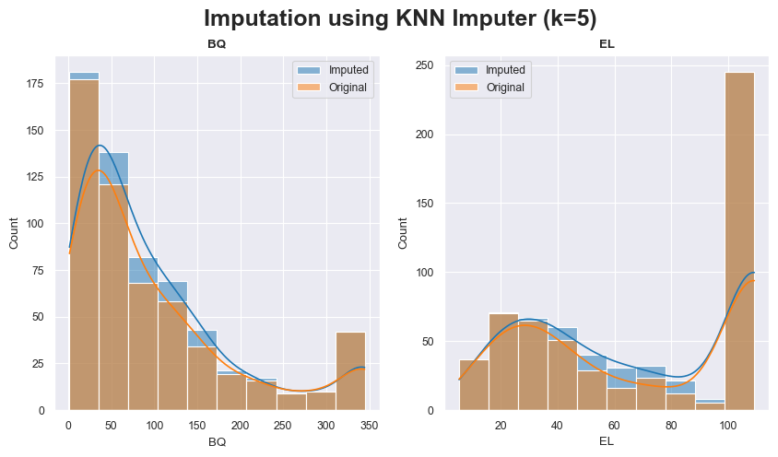
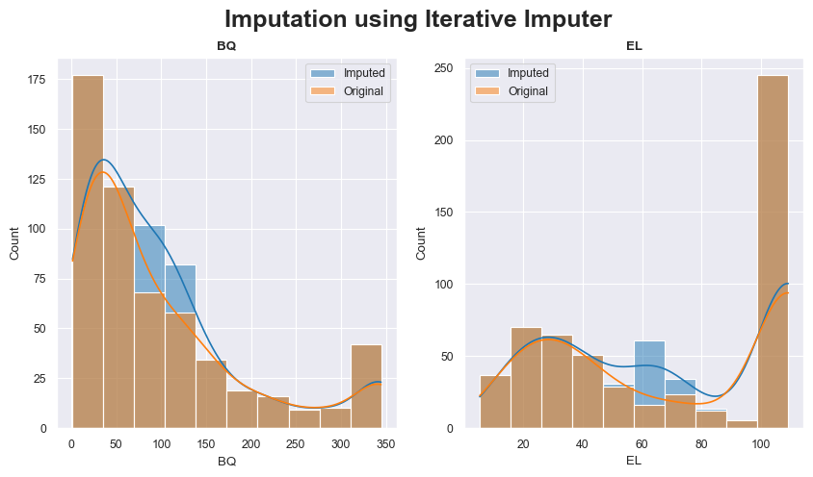
MISSING VALUES IMPUTATION
Regarding the other 2 features with around 10% of missing values, the best option is to impute those values, for that I tested 2 different solutions:
We can notice from the graphs above that KNN Imputer is able to bring new values to the data set without modifying its distribution, while Iterative Imputer is concentrating the new values around the mean of each feature, therefore modifying their distribution curves
Decision: Impute missing data with KNN Imputer!
(To de done after train/test split, to avoid data leakage)

Slide 30
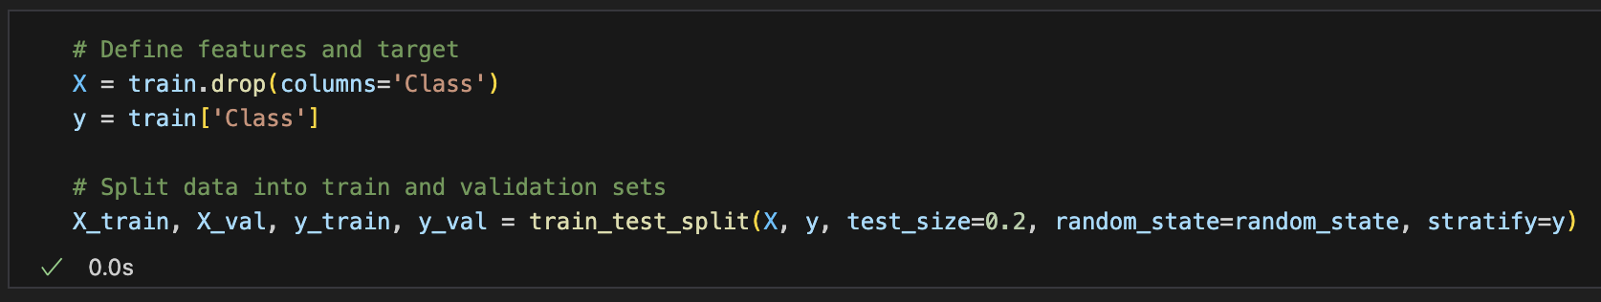
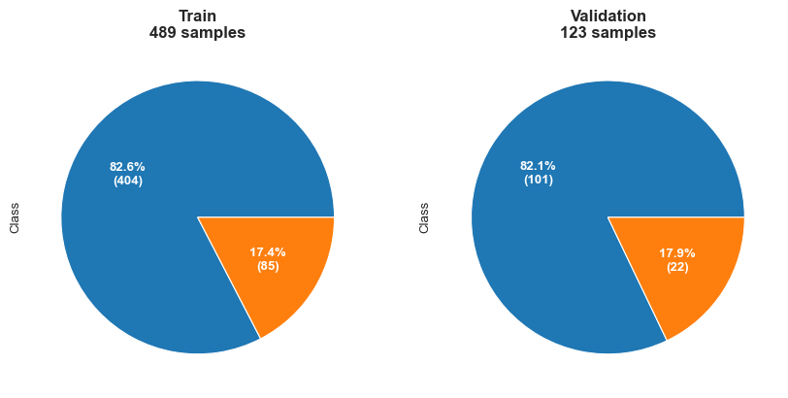
SPLIT TRAIN AND VALIDATION DATA SETS
Stratified division between train and validation data sets, to ensure the same distribution of targets between them.

Slide 31
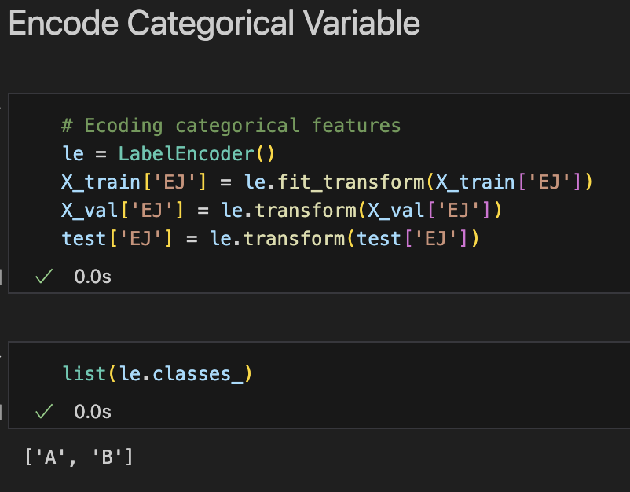
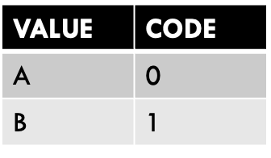
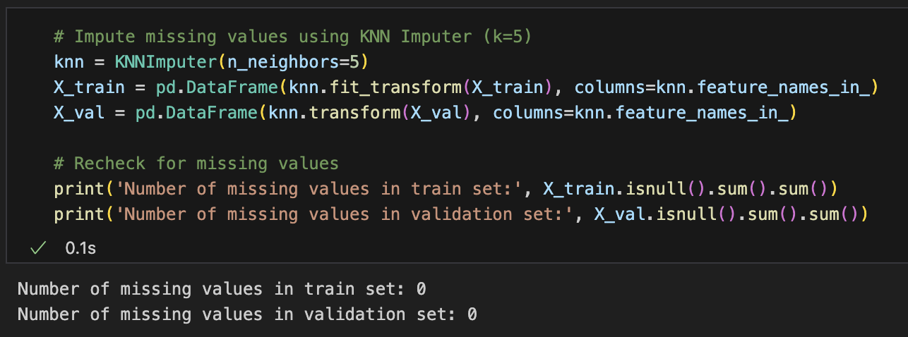
ENCODE CATEGORICAL VARIABLES
IMPUTE MISSING VARIABLES WITH KNN IMPUTER

Slide 32
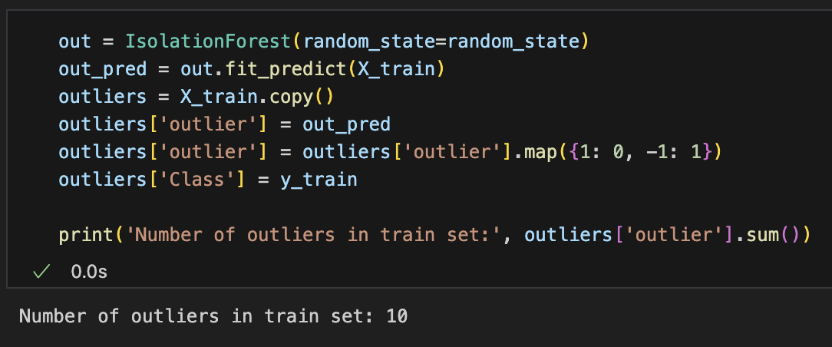
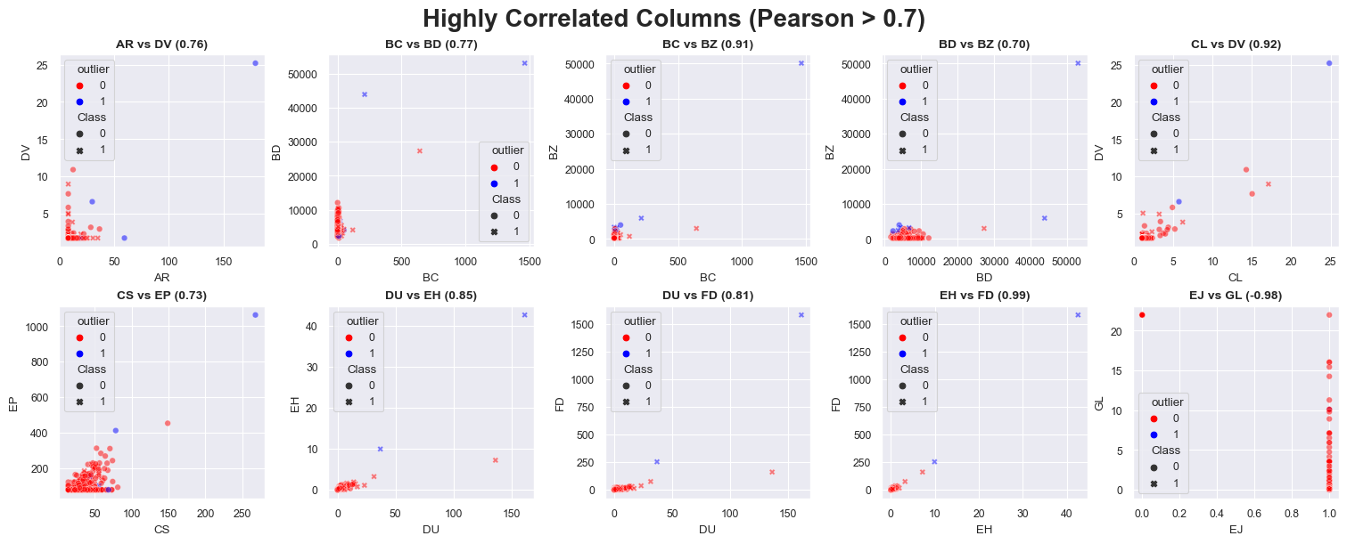
HANDLING OUTLIERS
Applying Isolation Forest, it found 10 outliers in the Train data set.
Looking deeper into this information and plotting the highly correlated features (below), it’s clear that the outliers (blue dots) are biasing the correlations.

Slide 33
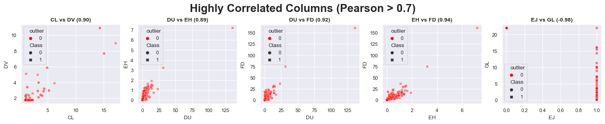
HANDLING OUTLIERS
If the outliers are removed, the number of highly correlated features drops to 5:
Decision: Drop outliers from Train Set!

Slide 34
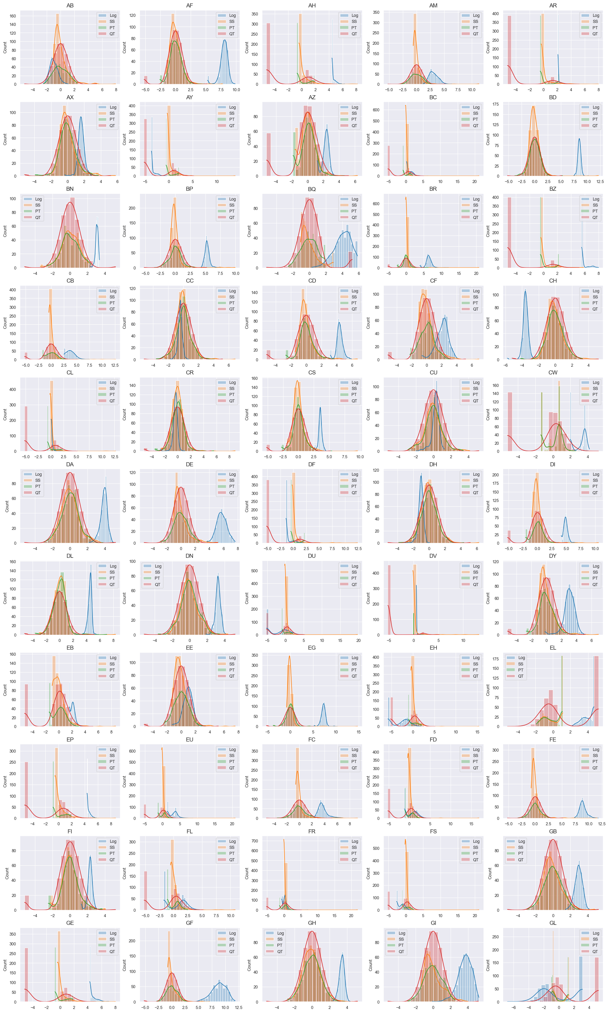
NORMALIZE AND STANDARDIZE
Performed trials with 4 different methods of scalers:

Slide 35
NORMALIZE AND STANDARDIZE
Decision: Use Power Transformer!

Slide 36
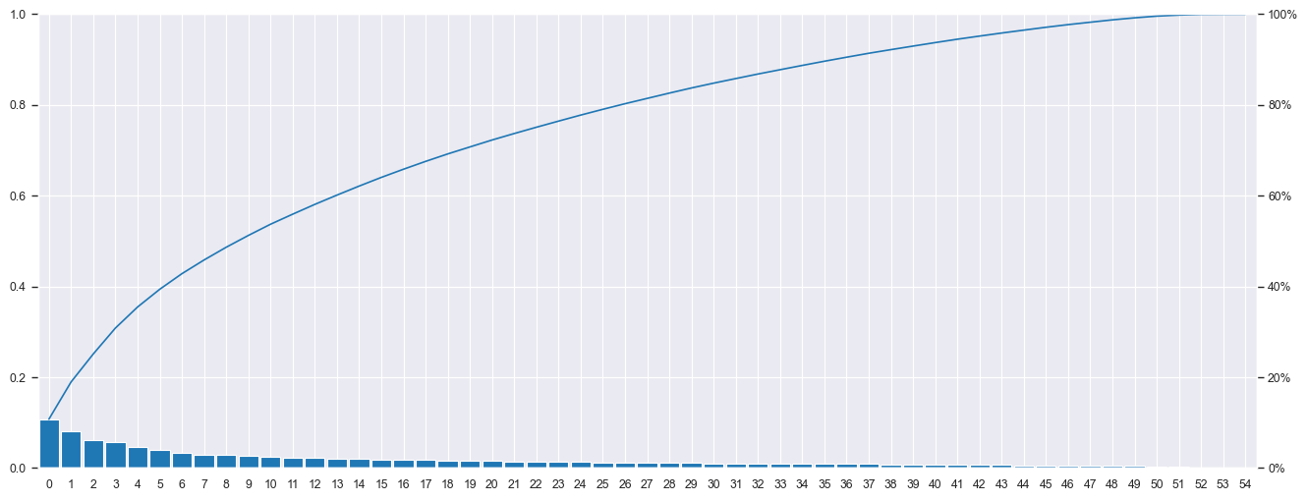
PRINCIPAL COMPONENT ANALYSIS (PCA)
Applying PCA made it possible to reduce the dimensionality of the data set from 55 to 28, keeping more than 85% of the explained variance.

Slide 37
data PREPARATION

Slide 38
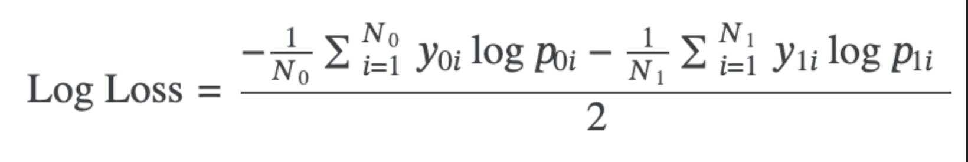
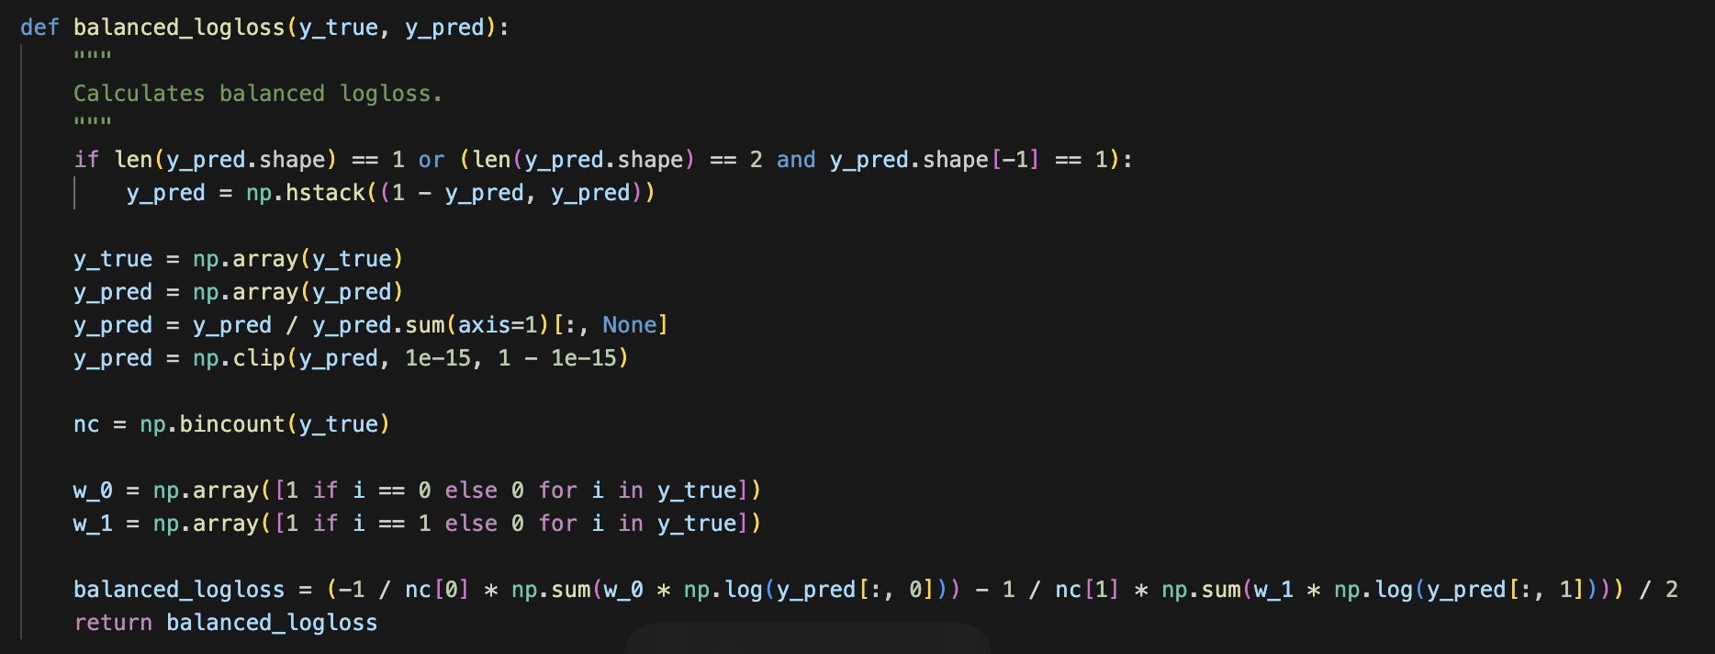
BALANCED LOGARITHMIC LOSS
The evaluation of the model will be done based on the above equation. In this case, the first action is to pass this equation to the code, to build the model using it as metric.

Slide 39
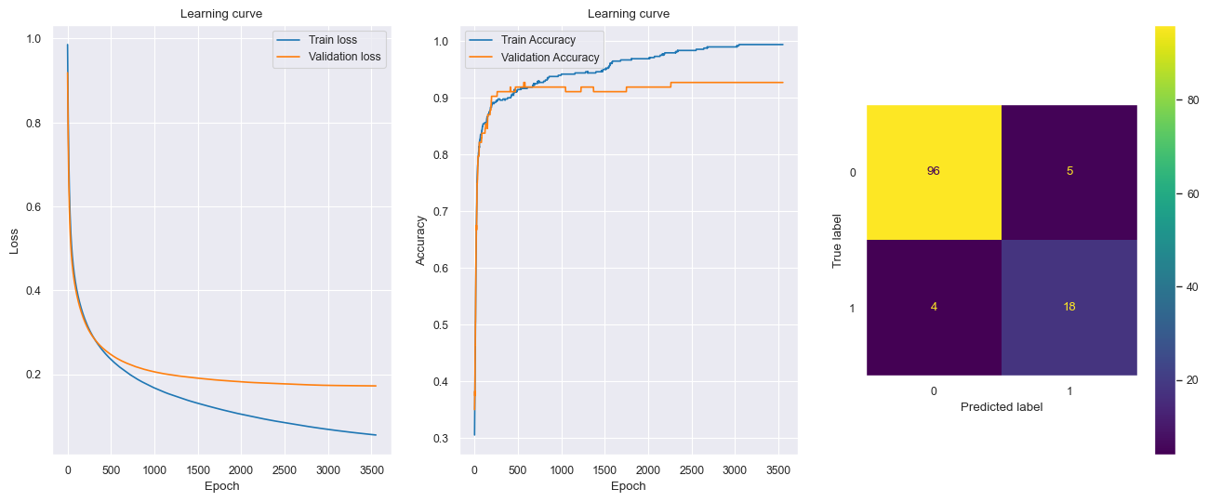
FIRST NEURAL NETWORK MODEL
The first model uses all the methodologies analyzed until now, but it does only 1 training, splitting the original train set into X, y Train (80%) and X, y Test (20%).
Results:
Balanced Log Loss: 0.2849
Accuracy: 0.9268

Slide 40
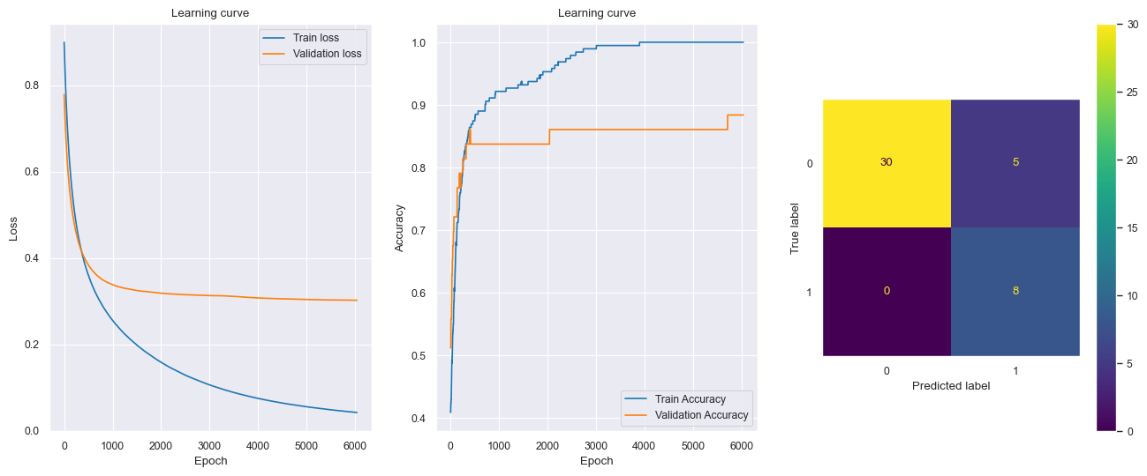
SPLIT TRAIN SET INTO 5 K-FOLDS AND BALANCE CLASSES
The second approach was to split the Train set into 5 K-folds, and balance each new train set with 50% of each class. Also each fold was initialized 5 times.
Best Results:
Balanced Log Loss: 0.2134
Accuracy: 0.8837

Slide 41
data PREPARATION

Slide 42
NEXT STEPS
There is still a lot of room for improvement, next steps are:
Create a class where it’s easier to change the parameters and perform more trial
Try with different scalers
Try with other quantities of PCAs
Change the number of neurons in the hidden layer
Try with other activation functions
Try different optimizers

